Slide 1
SETS
By : Amogh Garg

Slide 2
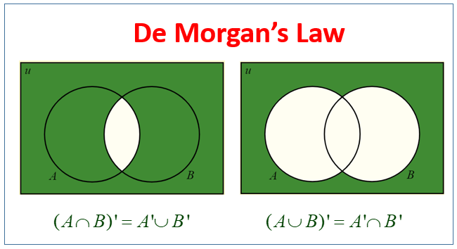
The Duality Principle
Any identity in set theory which uses any or all of the operations:
Set Intersection :∩
Set Union :∪
Empty set :∅
Universal set :U
and none other, remains valid if:
∩ and ∪ are exchanged throughout
∅ and U are exchanged throughout.

Slide 3
COUNTING AND SETS
Addition Principle
Multiplication Principle
Permutation and Combination

Slide 4
Addition Principle
It states that if event A can occur in m ways, and event B can occur in n disjoint ways, then the event “A or B” can occur in m + n ways.
EXAMPLE : How many two letter “words” start with either A or B?
ANS : We just need to select the second letter, which can be accomplished in 26 ways. So there are 26 words starting with A. There are also 26 words that start with B. To select a word which starts with either A or B, we can pick the word from the first 26 or the second 26, for a total of 52 words.

Slide 5
MULTIPLICATION PRINCIPLE/RULE OF PRODUCTS
It states that if event A can occur in m ways, and each possibility for A allows for exactly n ways for event B, then the event “A and B” can occur in m x n ways. OR
If there are n ways to perform action 1 and then by m ways to perform action 2, then there are n · m ways to perform action 1 followed by action 2.
EXAMPLE : Let A={1,2} and B={3,4,5}. Find A×B.
ANS : We want to find ordered pairs (a , b) where a can be either 1 or 2 and b can be either 3, 4, or 5. A×B is the set of all of these pairs: A×B={(1,3),(1,4),(1,5),(2,3),(2,4),(2,5)}.

Slide 6
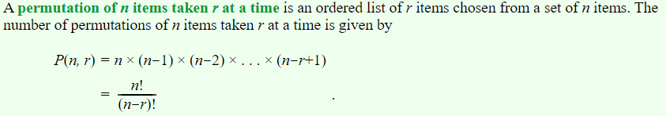
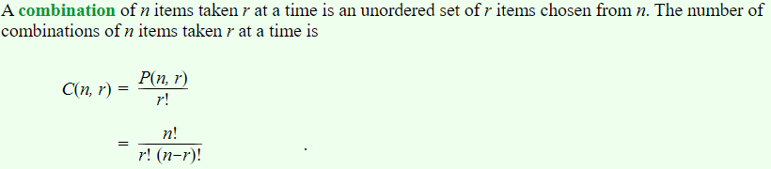
PERMUTATION AND COMBINATION
EXAMPLE : For example, the set {a, b, c} has six permutations: abc, acb, bac, bca, cab, cba
EXAMPLE : List all the combinations of 3 elements out of the set {a, b, c, d}. We can list all the combinations by listing all the subsets of exactly 3 elements. {a, b, c} {a, b, d} {a, c, d} {b, c, d}

Slide 7
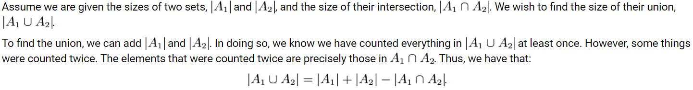
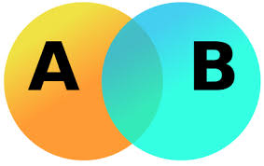
PRINCIPLE OF INCLUSION-EXCLUSION
The Principle of Inclusion-Exclusion (abbreviated PIE) provides an organized method/formula to find the number of elements n the union of a given group of sets, the size of each set, and the size of all possible intersections among the sets.

Slide 8
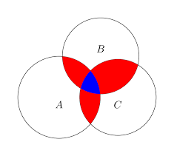
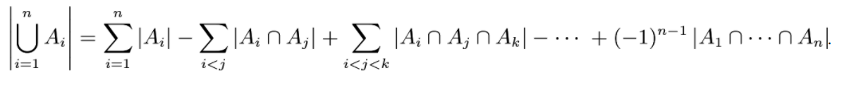
For three sets:
In General:

